Slide 1
BAS 475 Prediction Competition
Data predictions for the next 12 periods
Analytics Team: Sarah Libman, Kelton Rivas, Abigail Banas, and Scotty Wagner

Slide 2
Our goal
Our goal is to accurately predict monthly Imperial credit. Since we are far, far into the future, we are starting with the year 4999. We are predicting credit for the next 12 periods, from January 1, 4999 to January 1, 5040.

Slide 3
What we already know about the data
The data we are currently analyzing is supply chain information about the Empire’s credit. With each month, the Empire’s credit’s have steadily increased.

Slide 4
Data predictions process
Turning the data into a tsibble data-frame
Finding our lambda
01
02
03
04
Difference the data
Transforming the series
The lambda value is the power to which all the data should be raised to.
A tsibble is a type of time series object.
Differencing the data reduces variation.
Using our lambda value, we transform the data using the Box-Cox method. This makes our data more normal and increases linearity

Slide 5
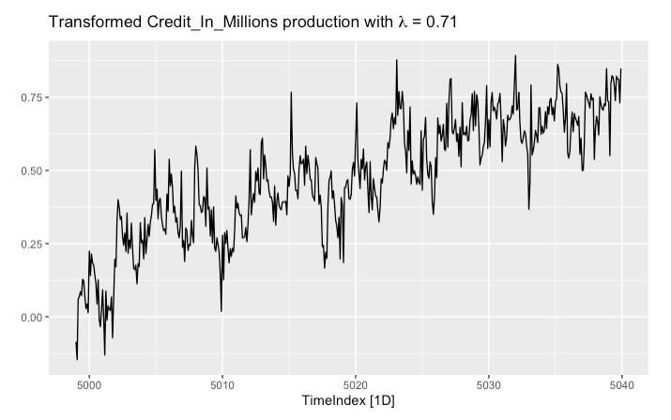
Box-Cox Autoplot of Transformed data.
What this reveals about the data:
After transforming the data utilizing the Box-Cox method, we were able to improve linearity and decrease heteroskedasticity. It also tells us that the Empire’s credit increases each month with an upward trend; with a peak in October.

Slide 6
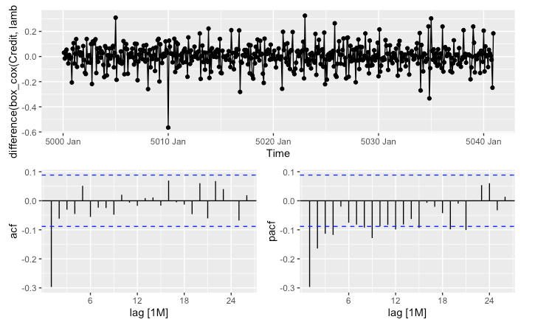
Using gg_tsdisplay
Differencing Transformed data
This plot displays the differenced data. Differencing data removes the upward trend and makes it more stationary. ACF looks like white noise; we have removed autocorrelation and the data is now fit for analysis.

Slide 7
Data predictions process (continued)
Creating the cross validation training data
Choosing a model
05
06
07
08
Producing and comparing models
Forecasting and making predictions
This will help us select a model that will have the lowest RMSE.
The model chosen that best describes the data will then be used for forecasting.
These models are compared to find one that best describes the data.
The last step is to make predictions for the next twelve periods of credit based on our model.

Slide 8
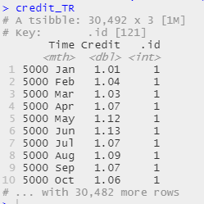
Creating Cross Validation Set
Differencing Transformed data
A stretched tsibble is created to safeguard against overfitting and to evaluate model performance.
This CV was built with .init = 12, which means that it was initially built with 1 year of data.
It was stretched over a period 4, which means that it added an additional 4 months

Slide 9
Model Comparison
ARIMA
Damped-Holt
Naive
ARIMA models aim to describe the autocorrelations within the data.
ARIMA models utilize root tests and minimisation of AICc to create the best model.
Dampened Holt-Winters models dampens the trend line to a flat line. This helps to prevent over-forecasting, reducing the chance of over-predicting.
Naive models are the most basic forecasting method models. They predict future events based on the single last value. In our case, it predicts next month’s credit based on the previous month’s credit.

Slide 10
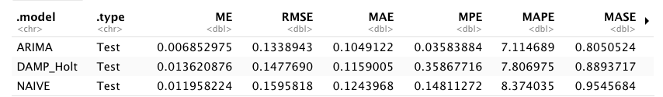
Best Model Choice
ARIMA
The ARIMA model we created had the lowest RMSE out of all of our models. This means among all of the models, this model had the smallest standard deviation of the residuals: the ARIMA model, on average, predicts more accurately than the Damp_Holt or Naive Model.

Slide 11
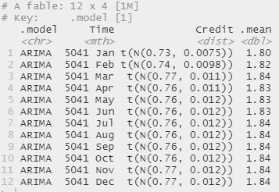
Forecasting and Making Predictions
Credit Predictions For Next Year
Our ARIMA model was used to predict the Imperial’s income for the future.
For example, January of 5041, we are expected to earn 1.8 million.

